Slide 1
Week - 5
Presented by:
Shafin Bin Hamid
Lecturer
Department of Electrical and Electronics Engineering
Bangladesh University of Engineering and Technology

Slide 2
Outline
Sinusoids
Phasors
Phasor calculations
Phasor relationship with circuit elements
Impedance and admittance
Kirchoff’s laws for phasors

Slide 3

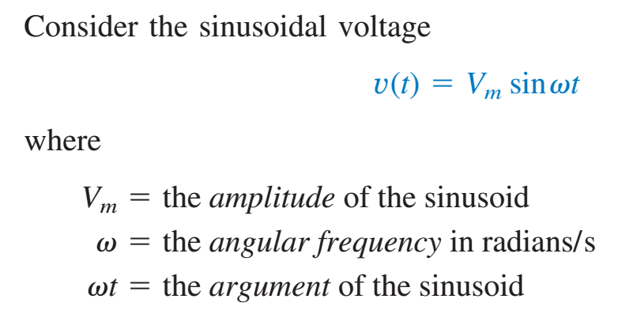
Sinusoids

Slide 4
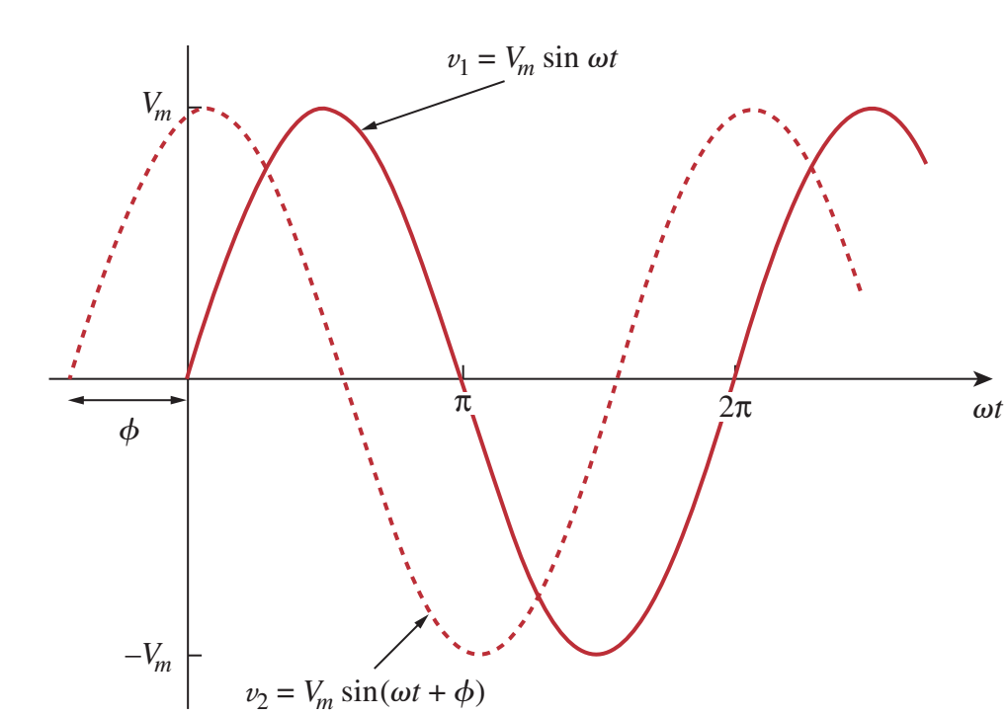

Two Sinusoids

Slide 5
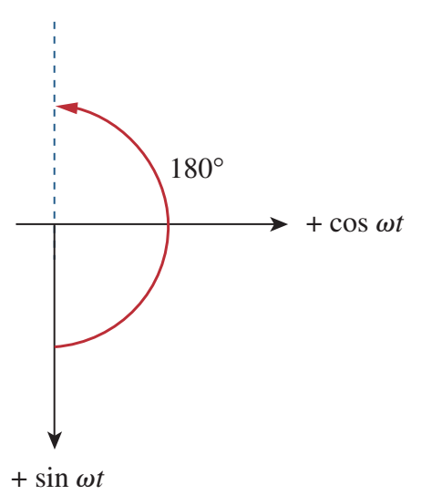
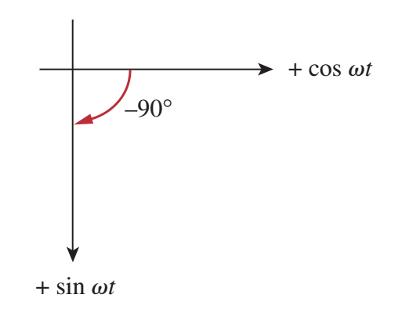
Graphical Approach

Slide 6

Graphical Approach

Slide 7
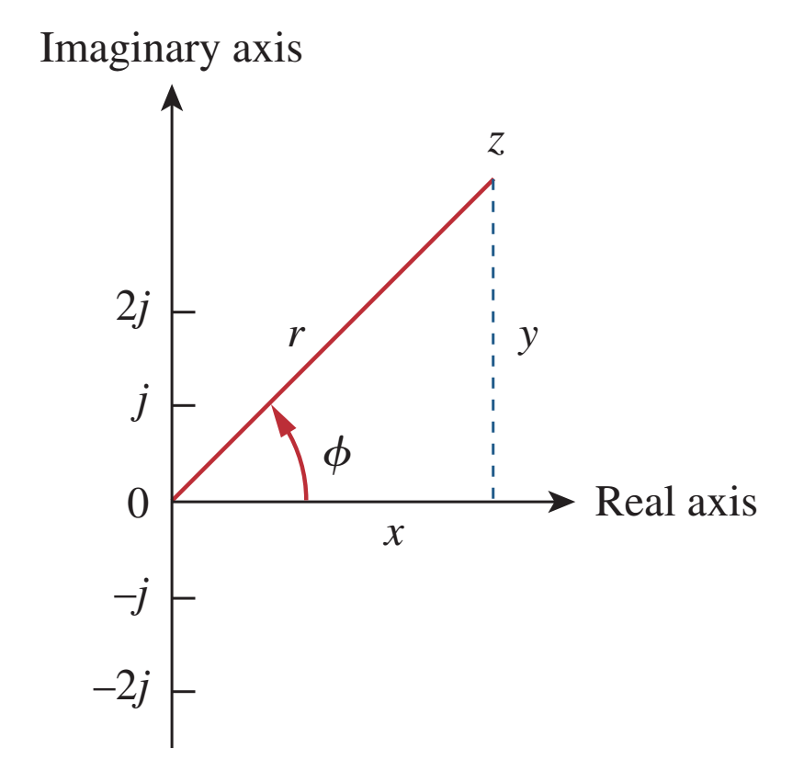
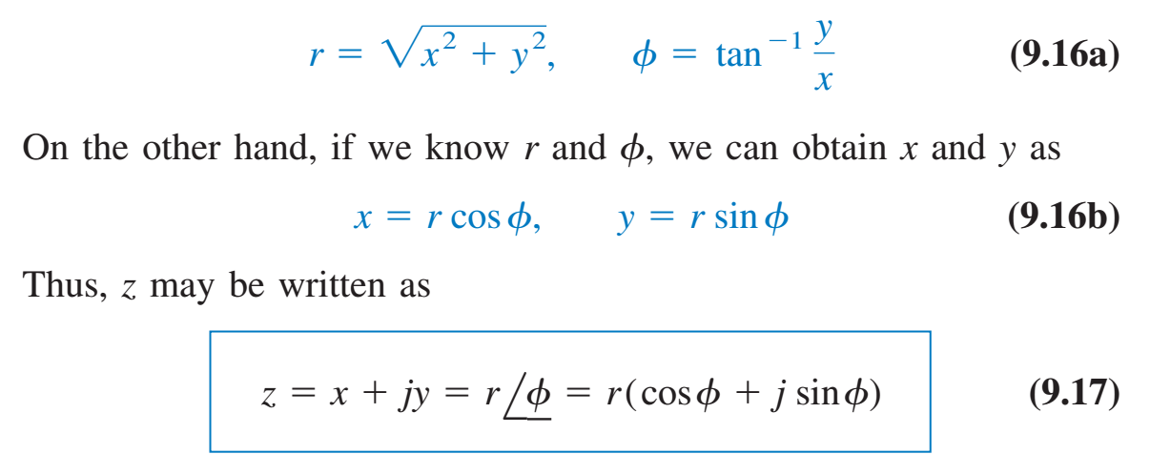
Phasor

Slide 8

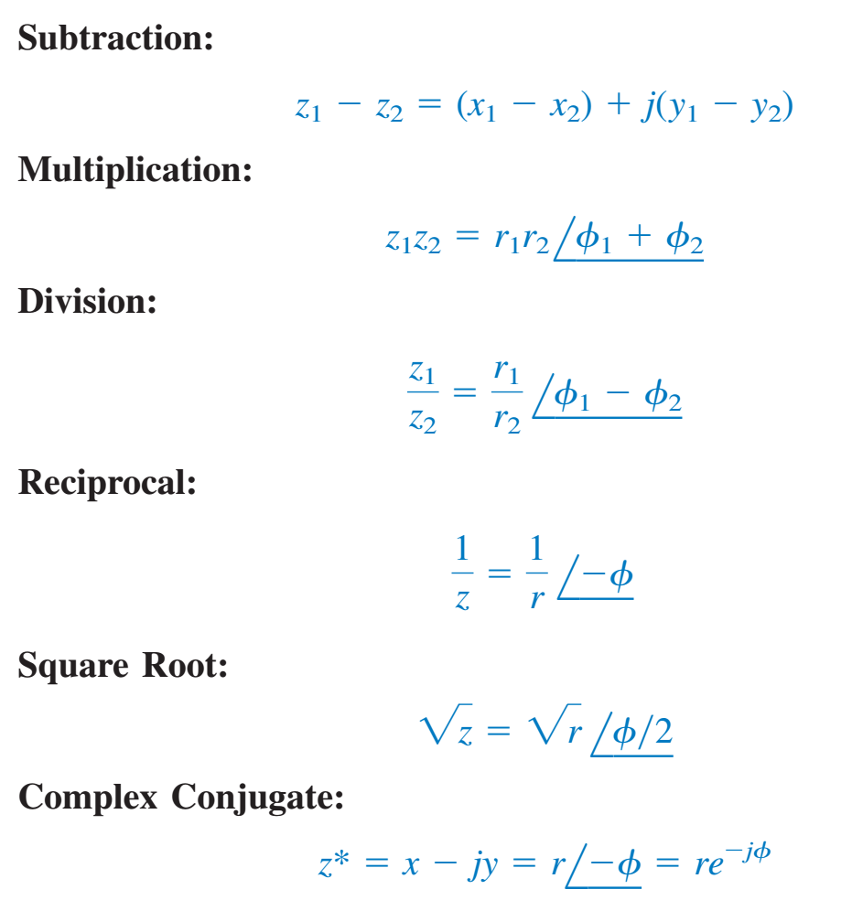
Phasor Rules

Slide 9
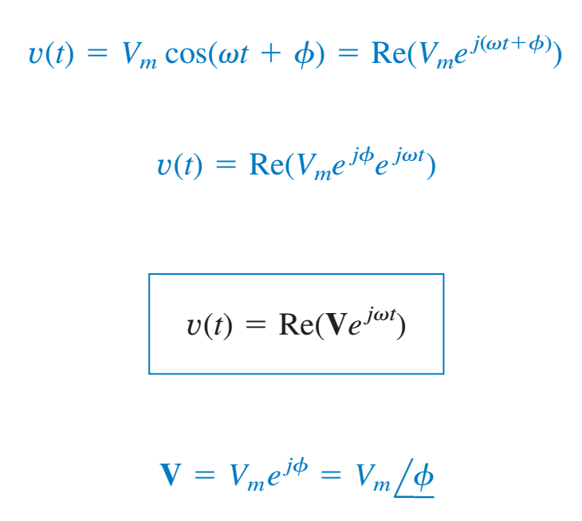
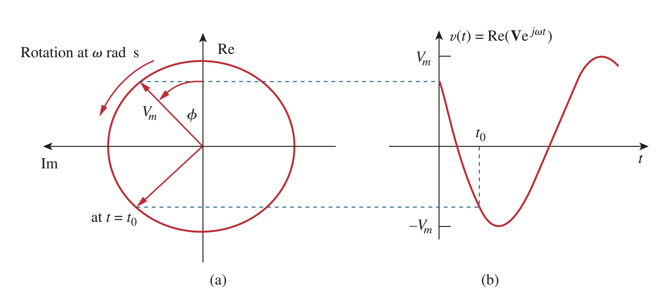

Voltage Phasor

Slide 10
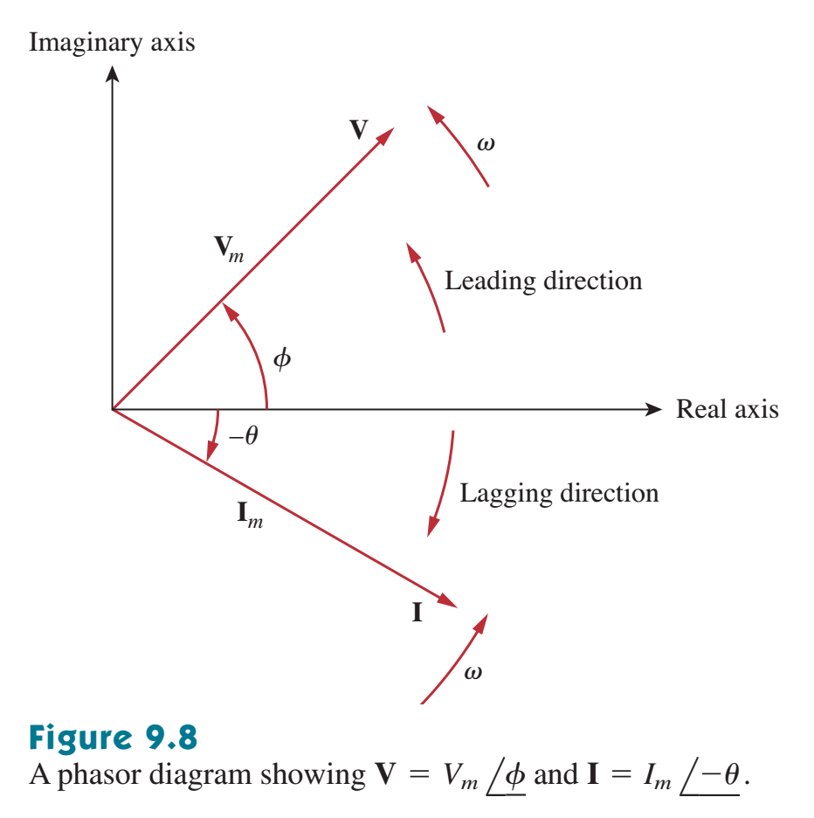
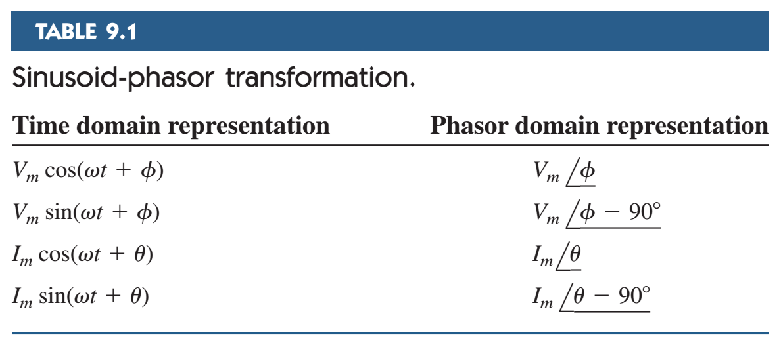
Leading and lagging phasors

Slide 11
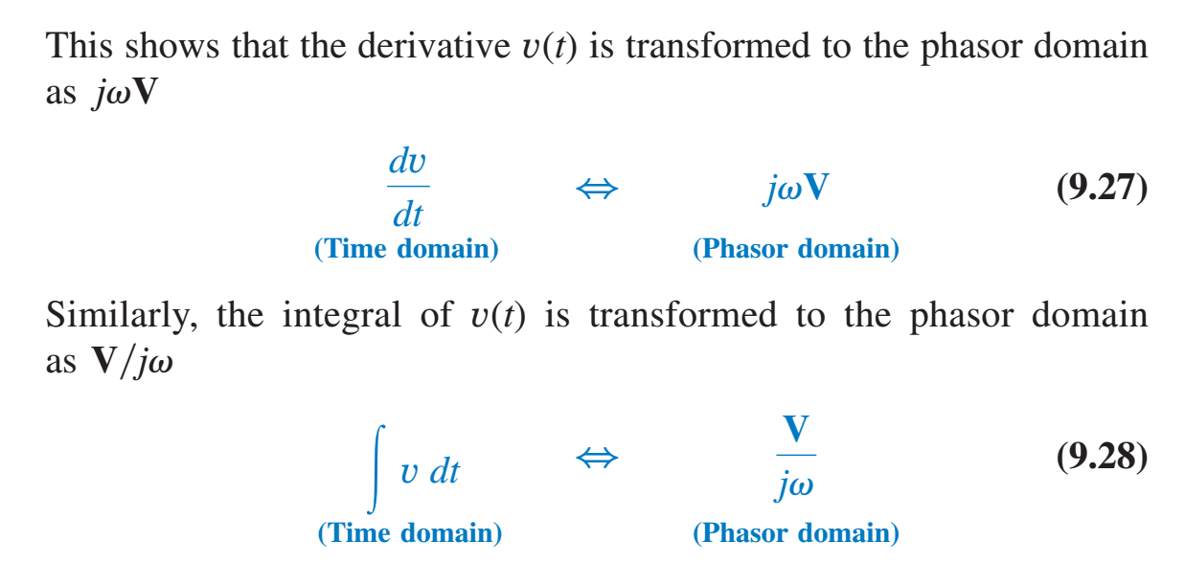
Derivative and Integral of Phasors

Slide 12
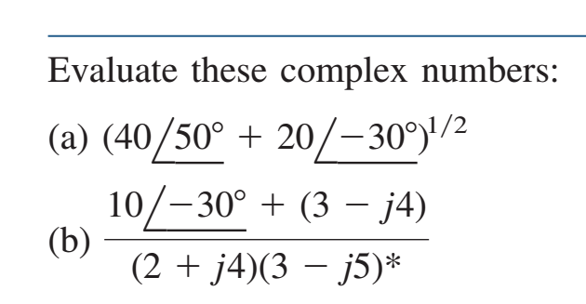

Phasor Calculation

Slide 13

Phasor Calculation

Slide 14
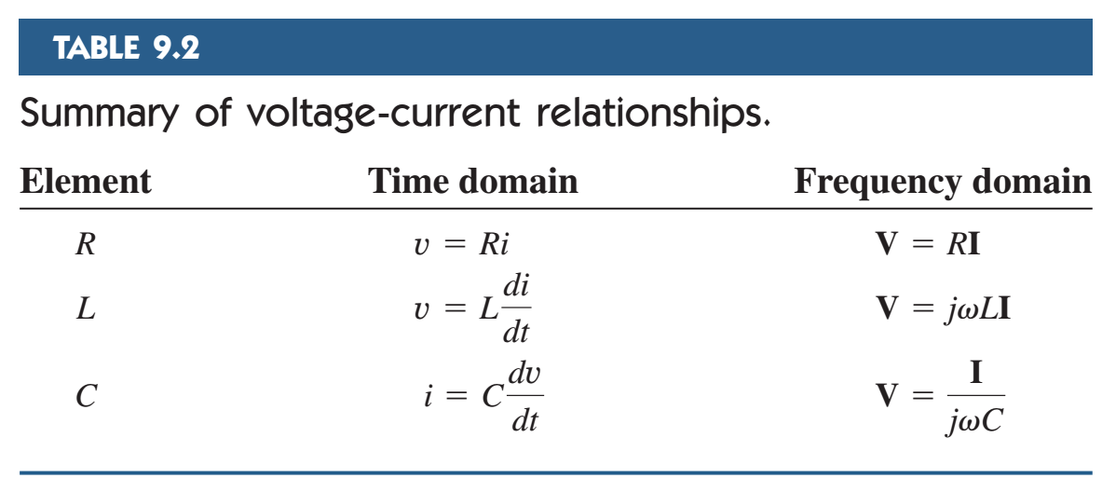
Phasor relationship with circuit elements

Slide 15

Phasor relationship with circuit elements

Slide 16

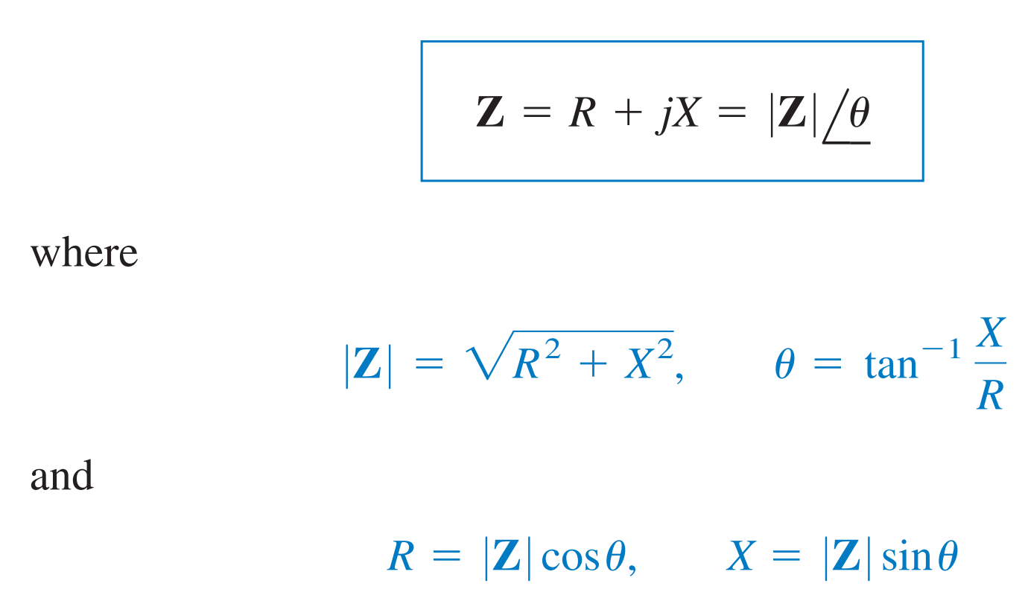
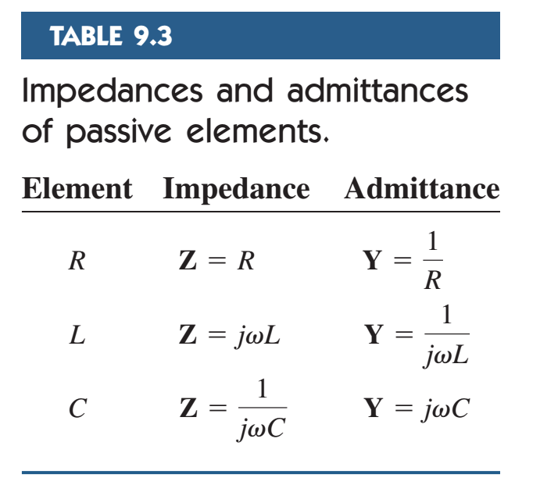
Impedance

Slide 17

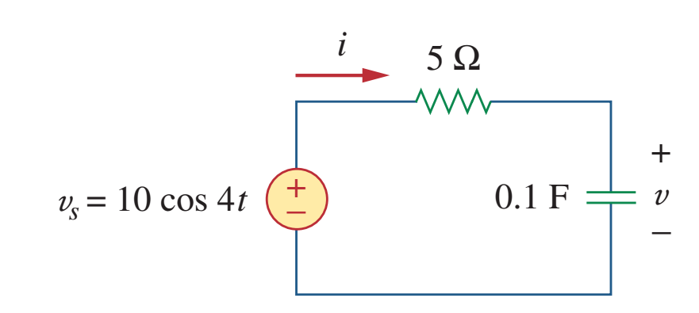
Problem

Slide 18
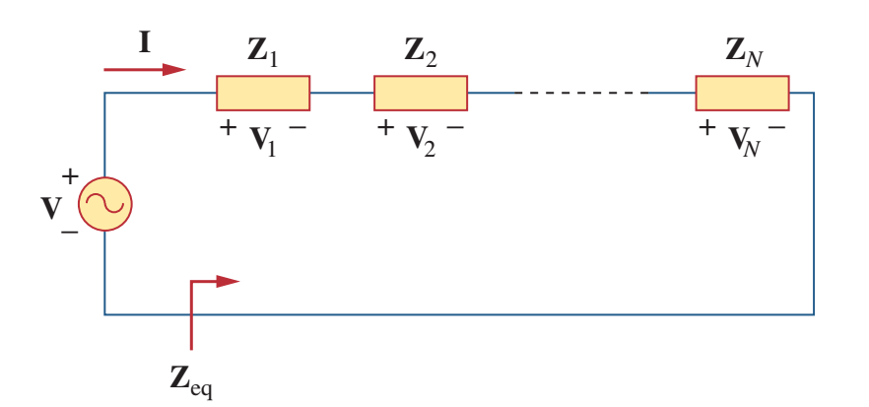



Kirchoff’s voltage law for phasors

Slide 19
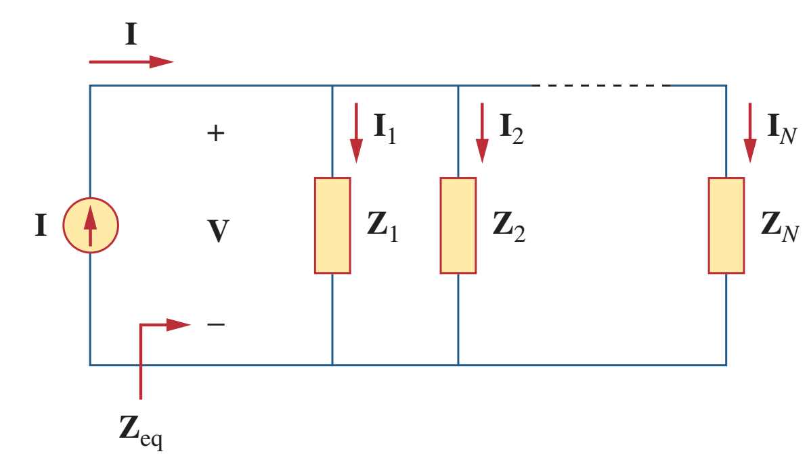



Kirchoff’s current law for phasors

Slide 20

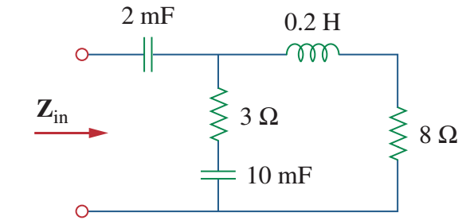
Problem

Slide 21

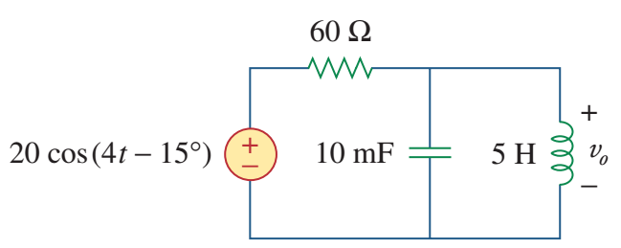
Problem

Slide 22


